Slide 1
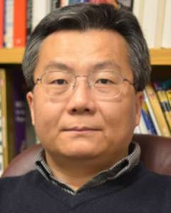
TITLE
Synthesis and Applications of FePt and Their Composite Nanoparticles
LECTURER
Shouheng Sun
BIOGRAPHY
Professor Sun received his Ph.D. degree in Chemistry from Brown University in 1996. He was a postdoctoral fellow from 1996-1998 and a research staff member from 1998-2004 at the IBM T. J. Watson Research Center. He joined the Chemistry Department of Brown University as a tenured Associate Professor in 2005 and was promoted to full Professor in 2007. He has been the Associate Director of Brown's Institute for Molecular and Nanoscale Innovation since 2008.
RESEARCH DESCRIPTION
Professor Sun‘s research in nanomaterials involves two related areas: (1) chemical synthesis and self-assembly of nanoparticles; (2) construction and elaboration of functional nanoparticles and their assemblies for applications in biomedicine, catalysis, and information storage. His studies were principally published in Science, Nature, J. Am. Chem. Soc, Angew. Chem. Int. Ed and Adv. Mater.
HONORS AND AWARDS
Cheung Kong Scholar Chair Professor, Ministry of Education/Nanjing University, China (2010) Potter Prize Advisor Award, Department of Chemistry, Brown University (2009) Research Seed Award, Brown Univ, 2008 Frontier Research Award, Dept of Chem., Brown Univ, 2006 Salomon Award, Brown Univ, 2006 Tenured, Brown Univ, 2005 Outstanding Technical Achievement Award (IBM, 2003) Master Inventor (IBM, 2002) Scientific Accomplishment Award (IBM, 2000) IBM Employee Award (IBM, 2000) Potter Prize (Ph.D. Thesis), Brown Univ, 1997 Sigma Xi Award, Brown Univ, 1996
时间：2012.07.06 10:30 地点：礼东二楼报告厅

